Slide 1






SafeNet

Slide 2




Group: 03
Supervised By: Md Al-Amin
Md Noman Islam
Md Nasimul Islam
Sadia Islam Mim
Sharmin Jahan
21-45453-3
21-45465-3
20-43436-1
21-45869-3

Slide 3
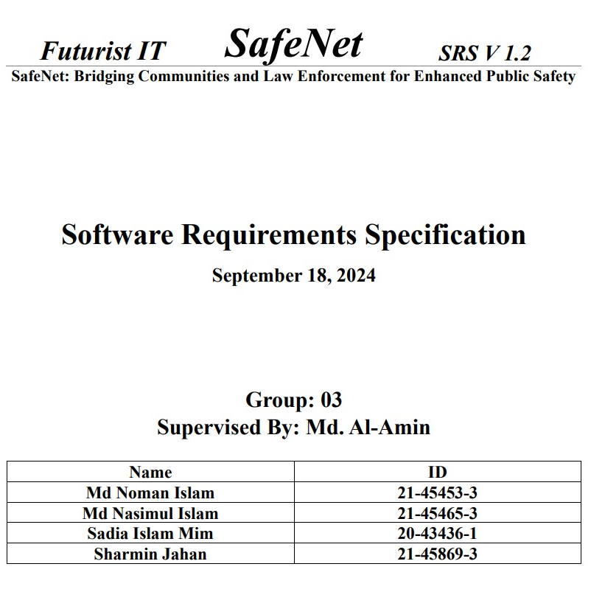
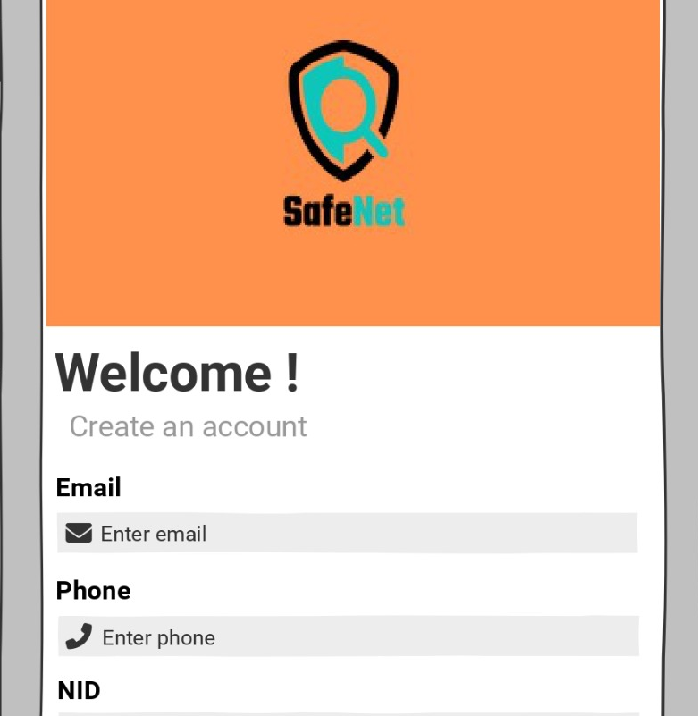

Topics
01
Introduction
02
Business Rules & Objectives
03
Stake Holders & Methodology
04
Functional Requirement
05
Non-Functional Requirement

Slide 4


Bridging Communities and Law Enforcement for Enhanced Public Safety
Introduction
SafeNet is a platform aimed at fostering trust and collaboration between communities and law enforcement agencies. The system offers quick access to police and medical emergency services, promotes officer accountability, and enhances public safety through community engagement in crime prevention

Slide 5
Business Rules
Objectives
Constraints
01
Business Rules
SafeNet operates under several key rules to enhance public safety and build trust between law enforcement and the community. It must provide reliable, real-time access to emergency services, including police and medical support, through location-based services. Police interactions are subject to transparency, with verified identification and a rating system to ensure accountability. The platform also ensures anonymous crime reporting, encouraging community involvement in crime prevention. Data protection and compliance with the Bangladesh ICT Act are mandatory, with encryption protocols and anonymity safeguards for sensitive information.
02
Business Objective
SafeNet aims to foster a safer society by promoting trust and transparency between citizens and law enforcement. Its primary objectives include improving response times through accurate location tracking and ensuring public access to emergency services. SafeNet also seeks to encourage accountability within the police force through performance ratings and reviews. By offering anonymous crime reporting, it strives to increase community involvement in crime prevention. Ultimately, SafeNet aims to create collaborative partnerships between law enforcement agencies and the community to enhance overall public safety.
03
Business Constraints
SafeNet must operate within legal, technical, and infrastructural constraints in Bangladesh. It must comply with public safety and data protection laws, including the Bangladesh ICT Act. Challenges may arise from disparities in technology across police stations, limited network coverage in rural areas, and ensuring platform scalability for a large user base. Real-time performance could be impacted by GPS and mobile network limitations, especially in remote regions. Additionally, law enforcement and health personnel may face challenges in adopting the platform, with constraints in training and long-term resource support.

Slide 6
Stakeholder
01
Customer
Police Department
Hospital Emergency
Medical Services
General Public
Platform Experts
02
User
Bangladeshi Citizen
Police Officers
Police Personnel
Health Provider
Developers
03
Product Chapion
Community Member
Policy Maker
High Ranked Police Officer
Police Personnel
Operator of Health Provide

Slide 7
Methodology
To gather requirements for SafeNet, a structured questionnaire was distributed to law enforcement agencies, healthcare centers, and local government representatives, focusing on their operational challenges and feature needs. In-depth interviews were conducted with police officers, emergency responders, and community leaders to explore workflow and integration nuances. Online surveys targeted the general public to understand their concerns and expectations regarding public safety. The collected feedback was then summarized to identify key priorities, challenges, and desired features from each stakeholder group.
01
03
Survey
Questionnaire
02
04
Customer Feedback
Interview

Slide 8
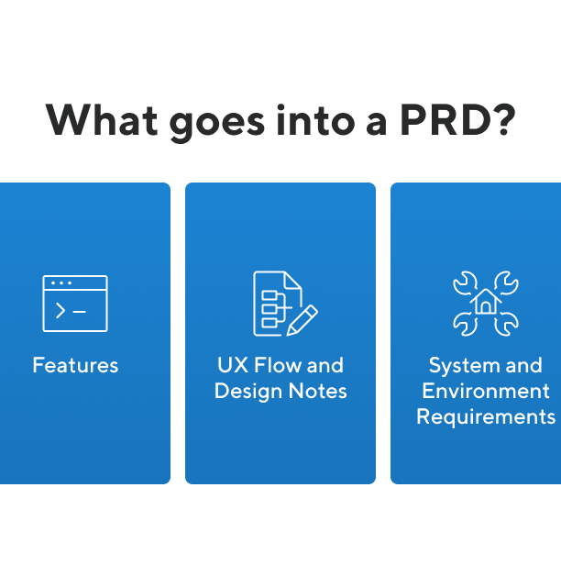
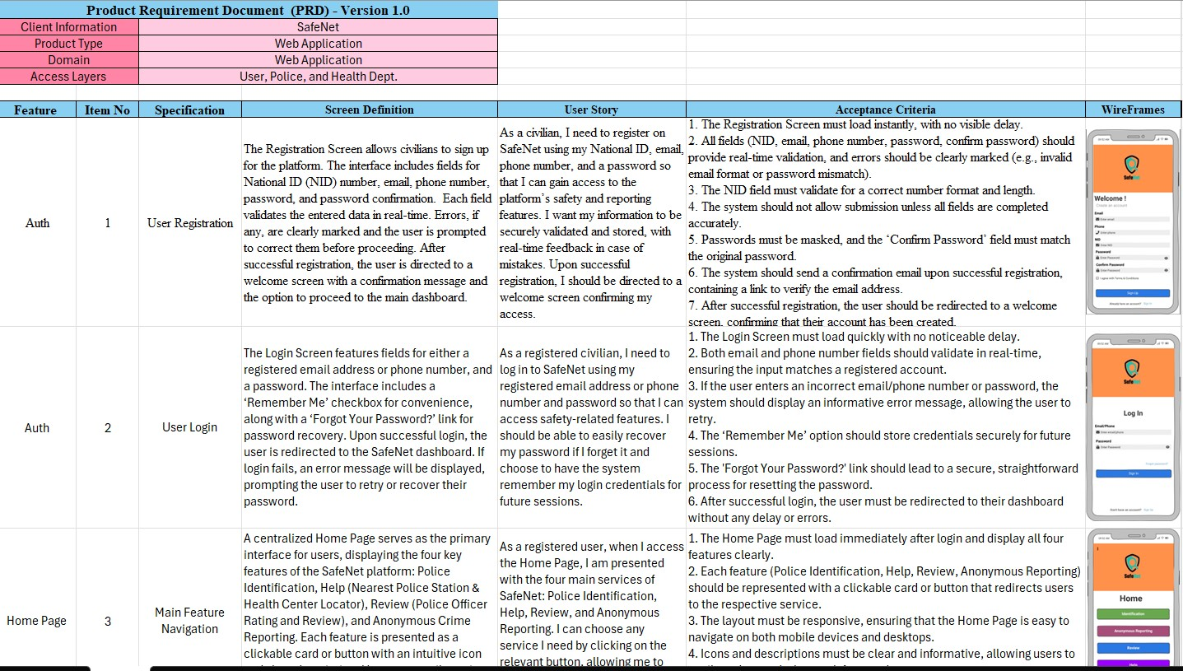
Functional
Requirement
12
Features
23
Specifications
Includes
Screen Definition, User Story,
Acceptance Criteria, Wireframes

Slide 9
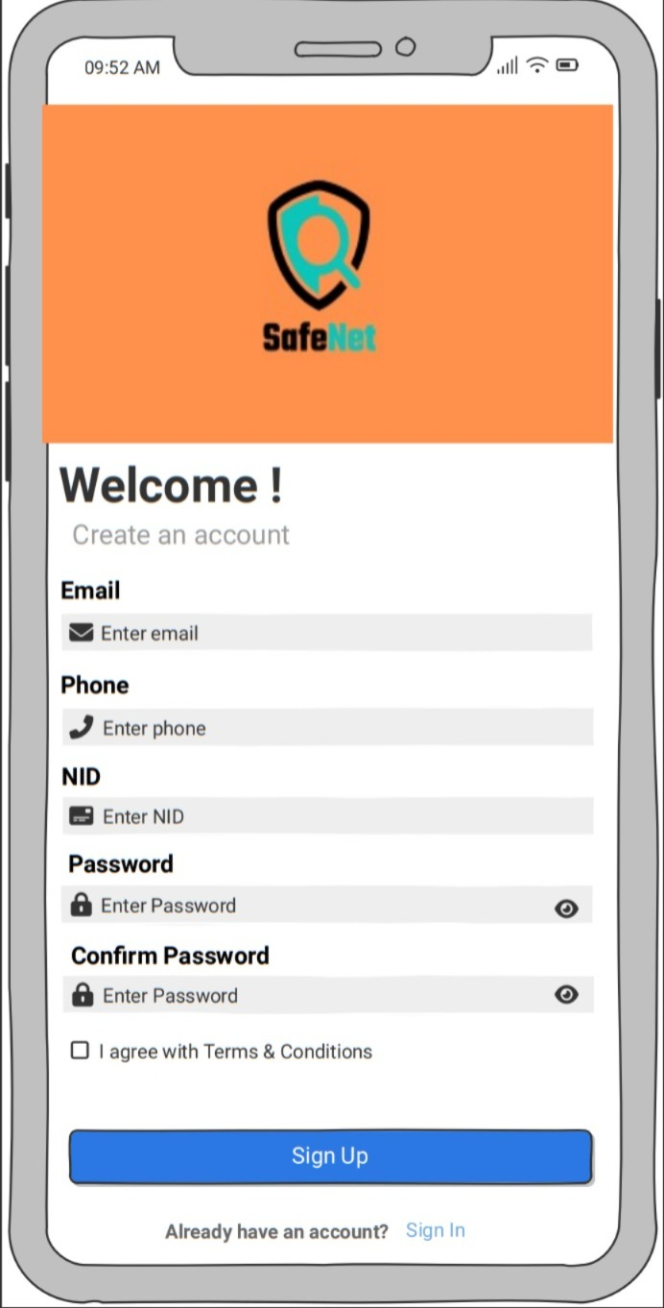
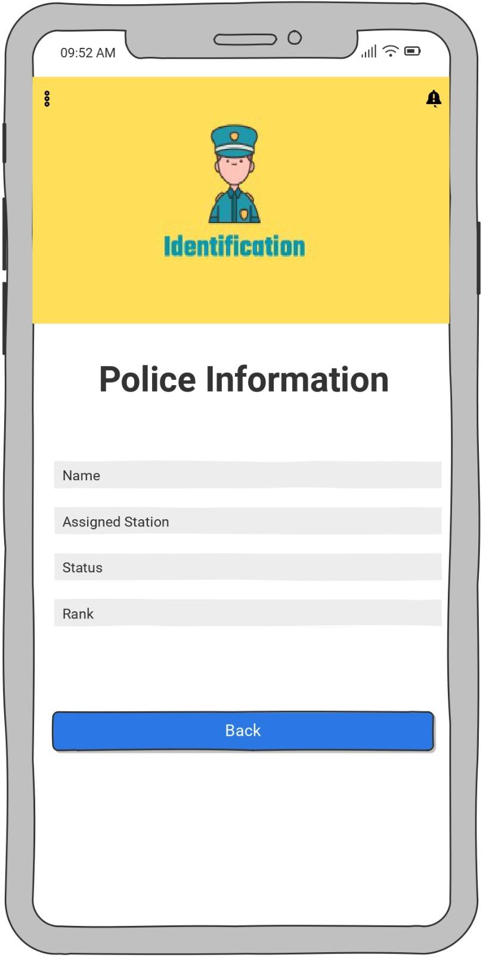
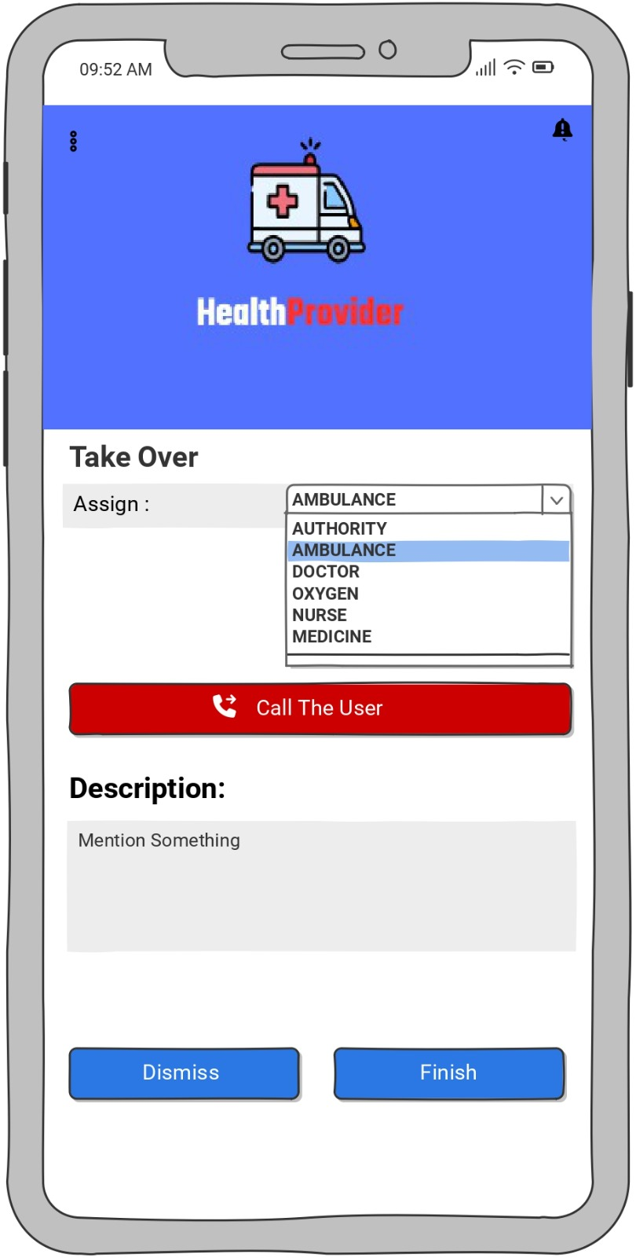
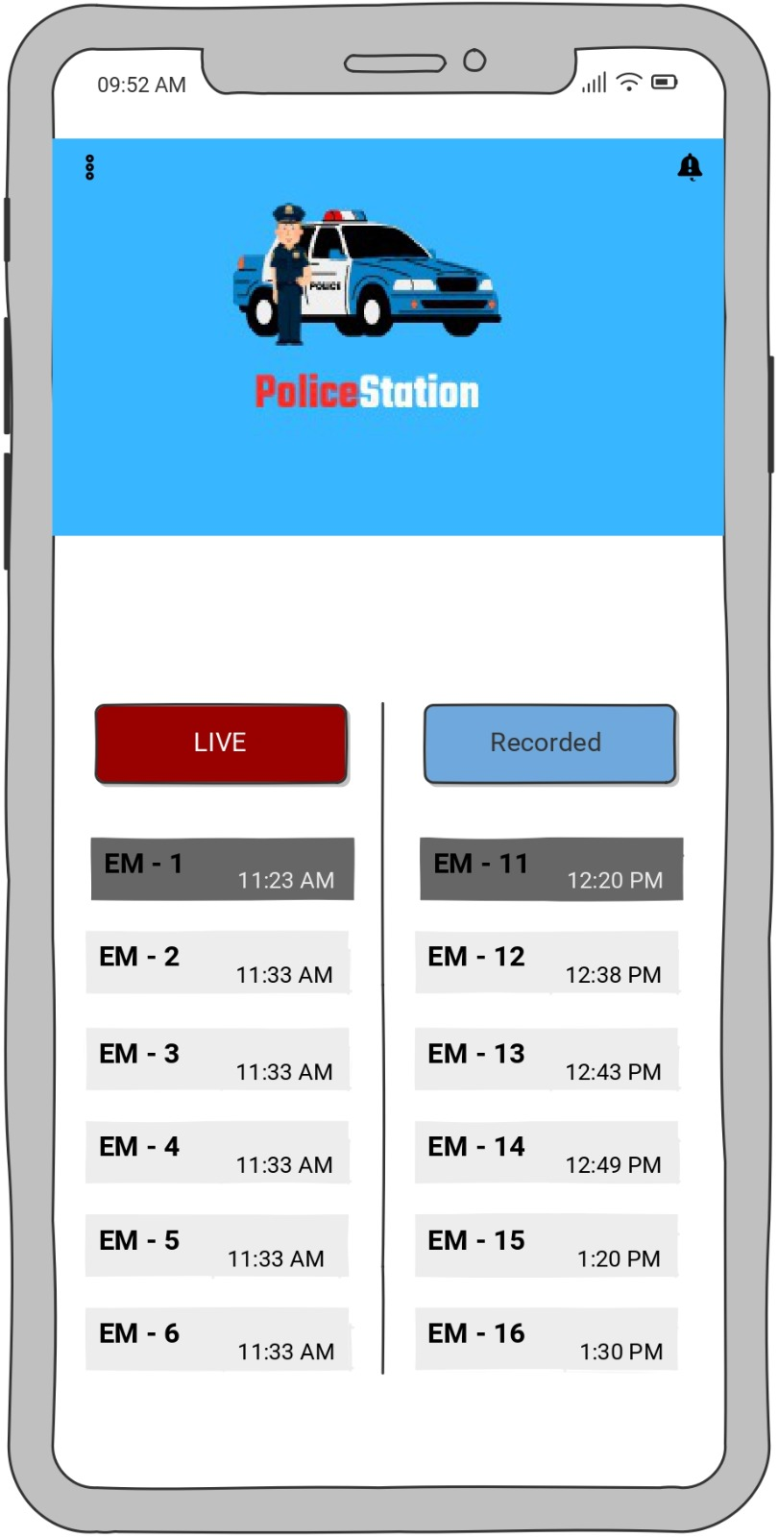
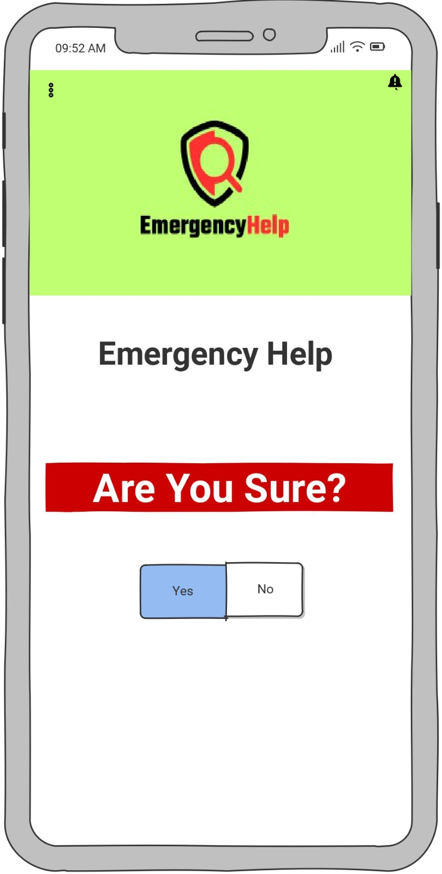
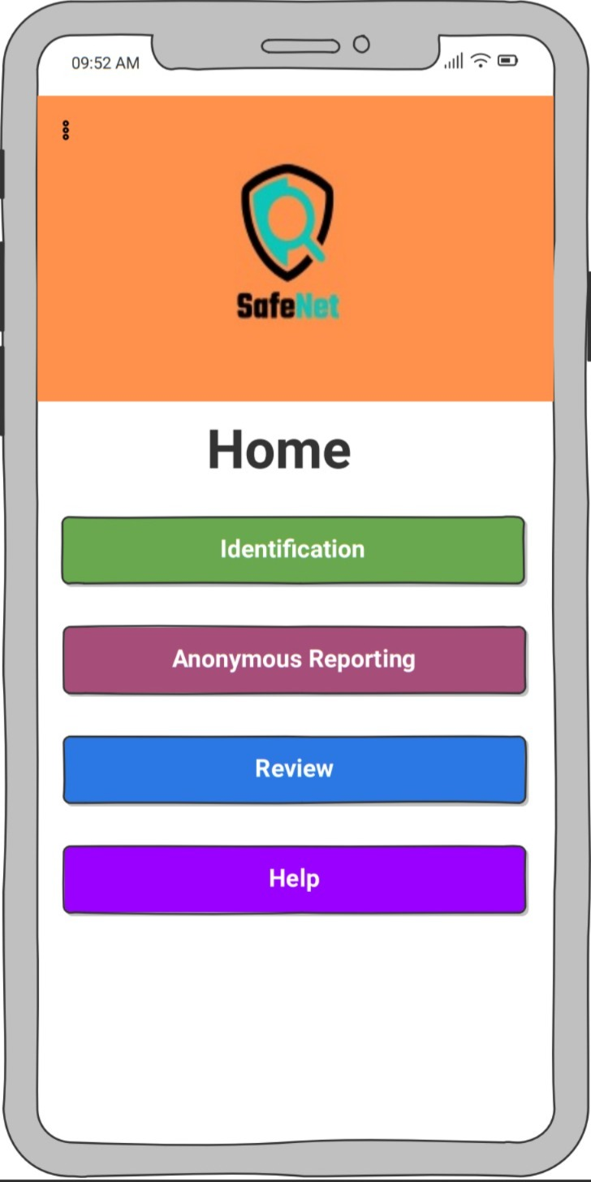
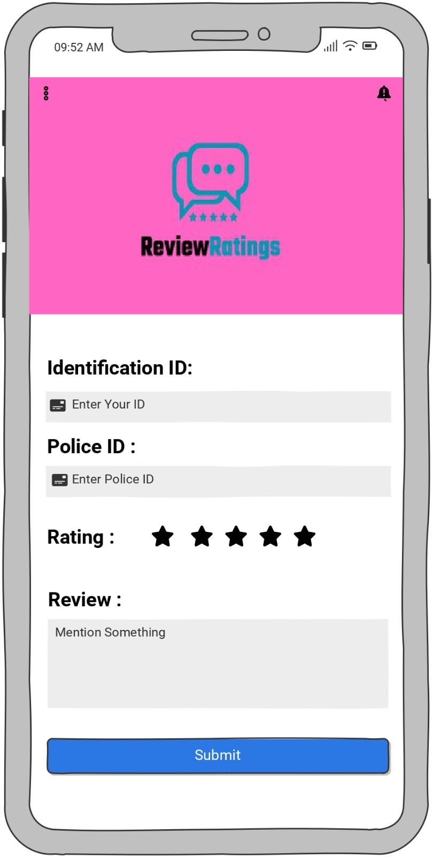
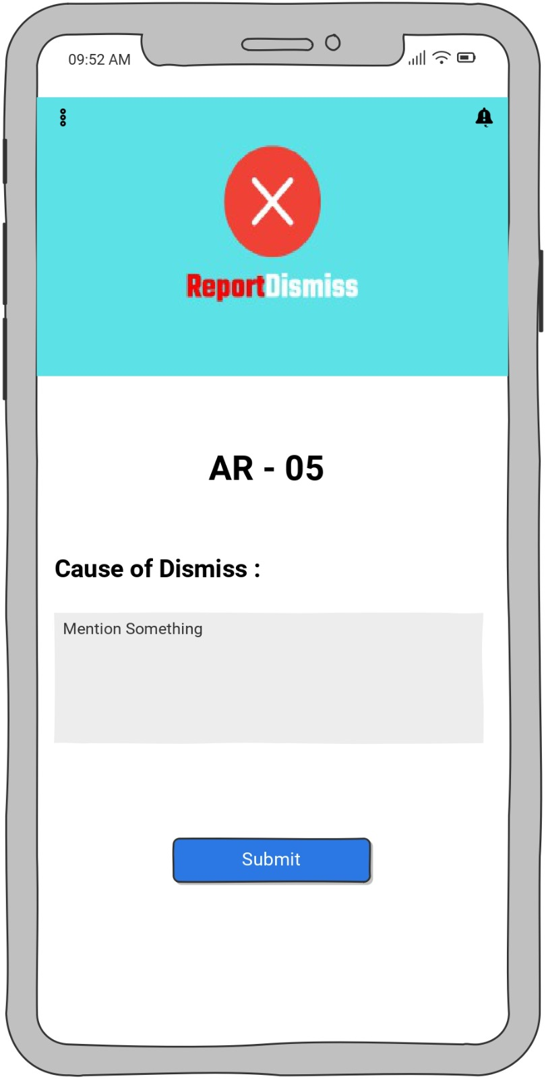
Wireframes

Slide 10
Non- Functional Requirement
The non-functional requirements for SafeNet ensure accessibility, security, and performance across multiple platforms. The platform must be user-friendly, compatible with major browsers and mobile systems, and provide accessibility features for disabled users. Data security is a priority, with encryption and compliance with data protection regulations, restricting sensitive information to authorized personnel. The platform must be reliable, offering 24/7 availability with fast response times (under 5 seconds) and the ability to support high volumes of simultaneous users without performance issues. These requirements aim to create a secure, efficient, and accessible public safety platform.
01
03
Performance
Accessibility & Usability
02
04
Compatibility
Security & Reliability

Slide 11
Thank You

